Slide 1
Predicting credit card approval
Presented by Jared obozele

Slide 2
Agenda
Background
Analysis of Dataset
Model Performance
Best Model
Conclusion & Next Steps

Slide 3
Background
Two Datasets
Credit Card Application Dataset
Credit Record Dataset
Credit Record and Application factors combine to make decision on whether a person is deemed in good standing for approval or not
The Datasets need to be merged after analysis to be begin model predictions
21 columns and over 400,000 rows of data

Slide 4
Background
STATUS -
0: 1-29 days past due
1: 30-59 days past due
2: 60-89 days overdue
3: 90-119 days overdue
4: 120-149 days overdue
5: Overdue or bad debts, write-offs for more than 150 days
C: paid off that month
X: No loan for the month

Slide 5
Background
Previous models used: Logistic Regression, Perceptron, Gaussian – Naïve Bayes

Slide 6
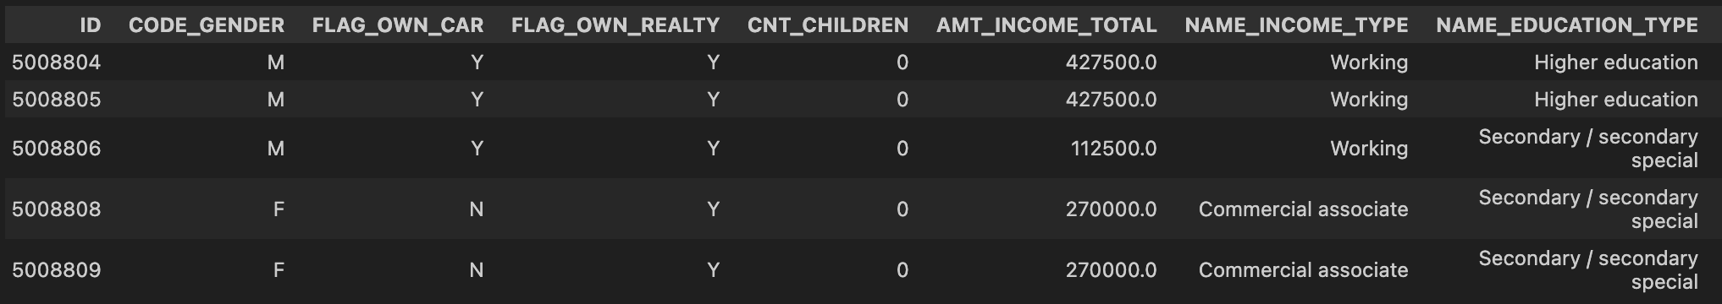
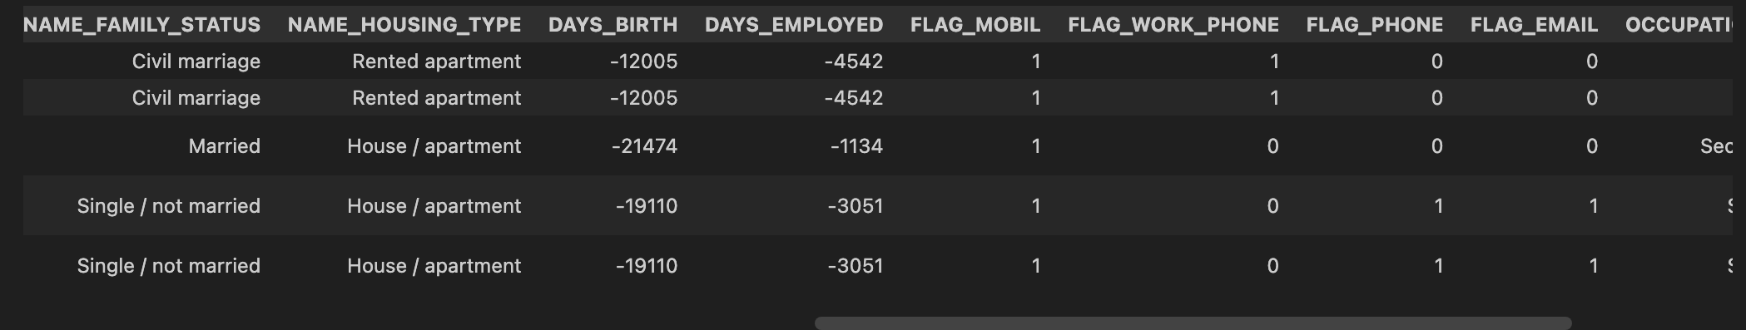
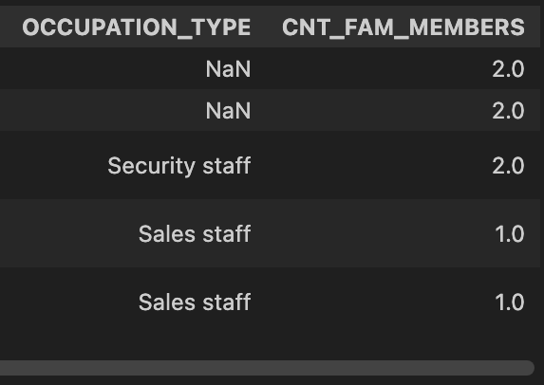
Analysis of Datasets
Credit Card Application Data

Slide 7
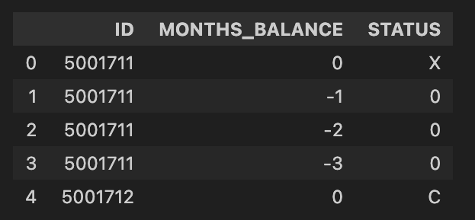
Analysis of Datasets
Credit Card Record Data

Slide 8
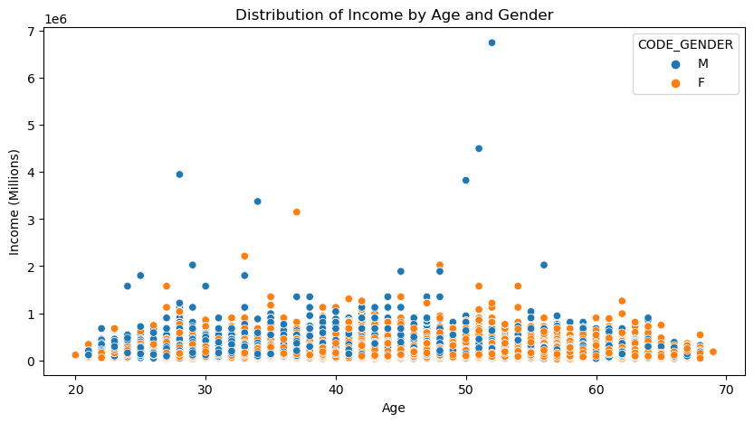
Analysis of Datasets
Distribution of Income by Age and Gender

Slide 9
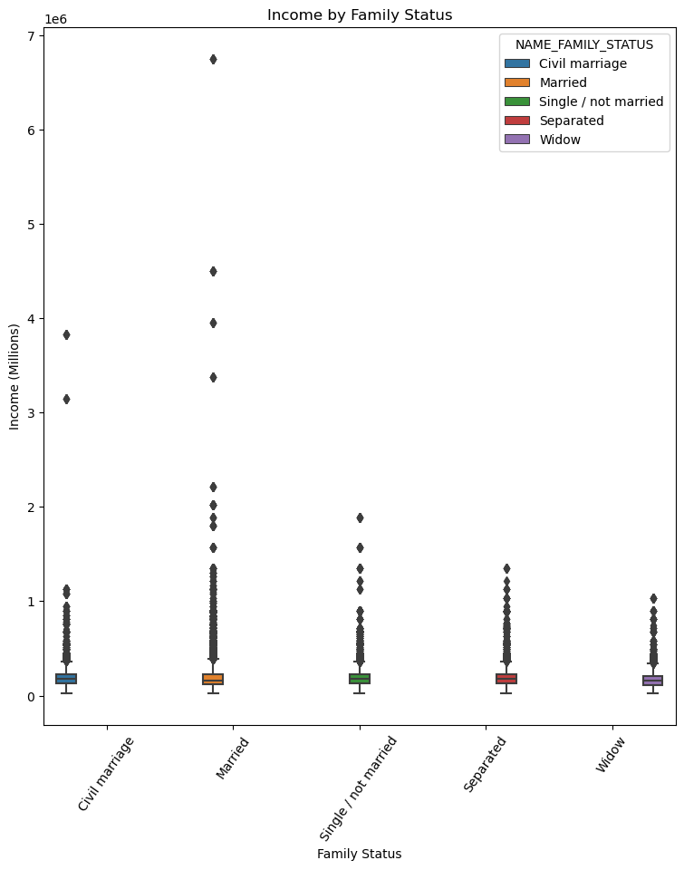
Analysis of Datasets
Income by Family Status

Slide 10
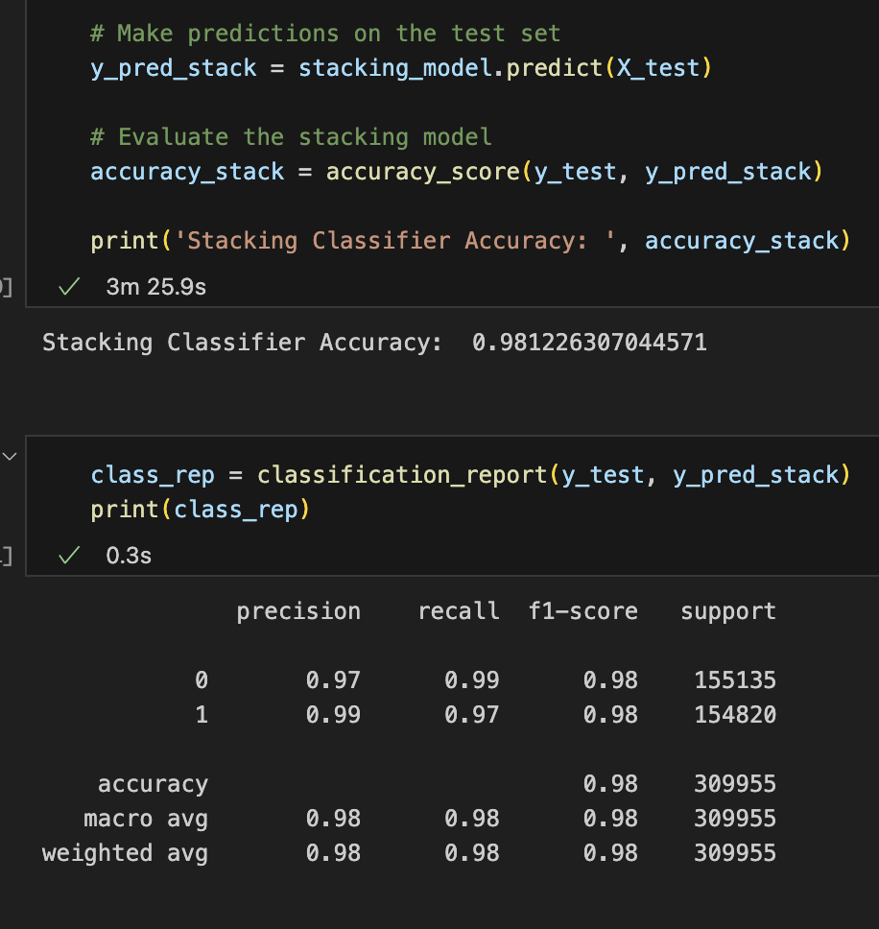
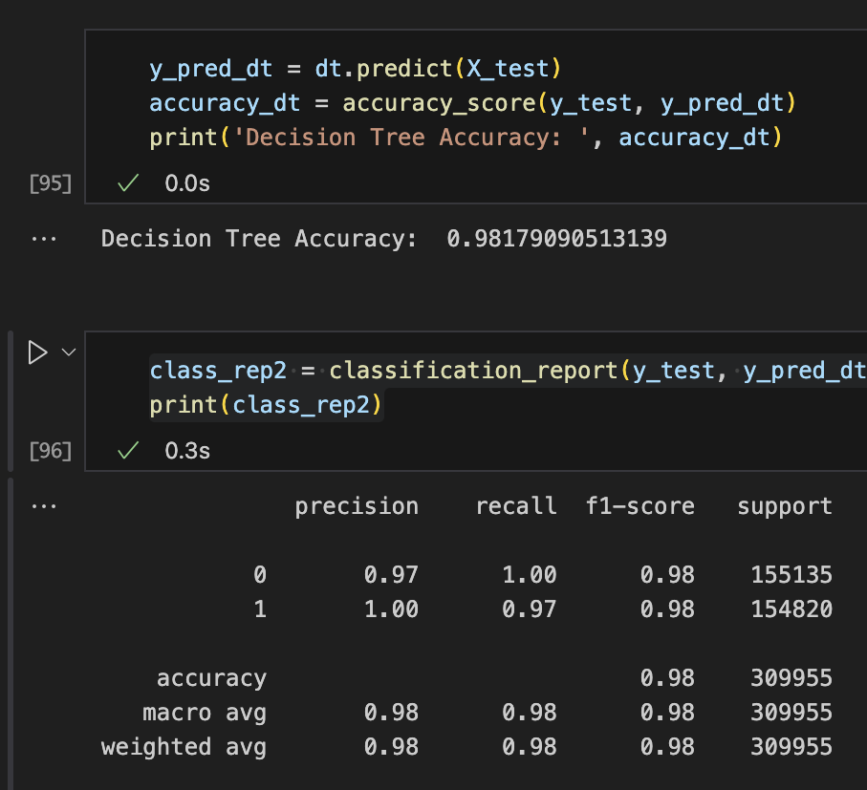
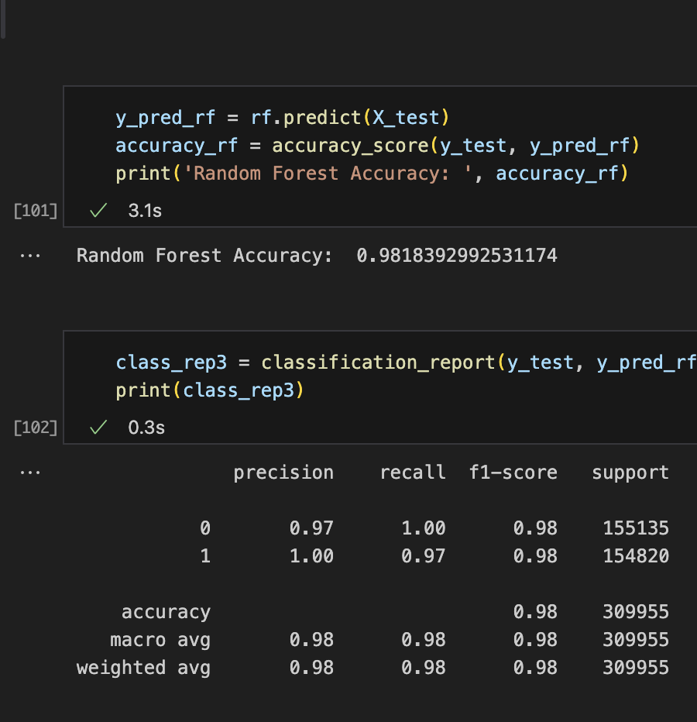
Model comparison
Stacking Classifier Model
Decision Tree Model
Random Forest Model

Slide 11
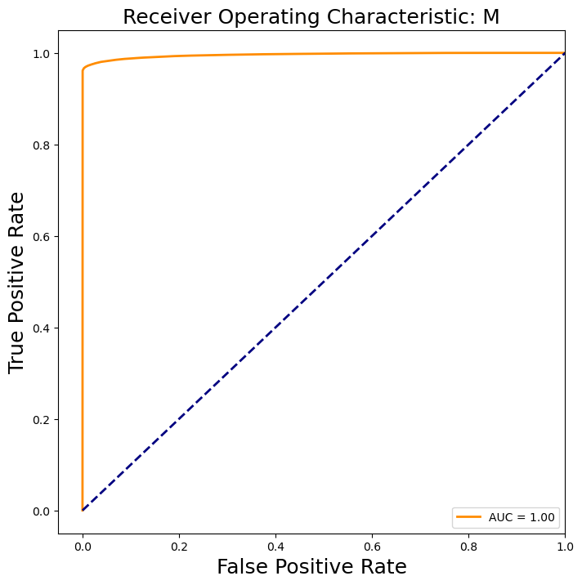
Best Performing Model
Random Forest Model: Accuracy 98.183%

Slide 12
Conclusions & Next steps
Random Forest performed the best as expected
Logistic Regression struggled to improve performance with boosting on the data and only showed improvement when becoming a base learner to random forest, decision tree, and perceptron weak learners
Need to analyze overfitting due to such strong model performance
Data could be cleaned and organized better during this

Slide 13
Thank you For listening! Questions?

